Slide 1
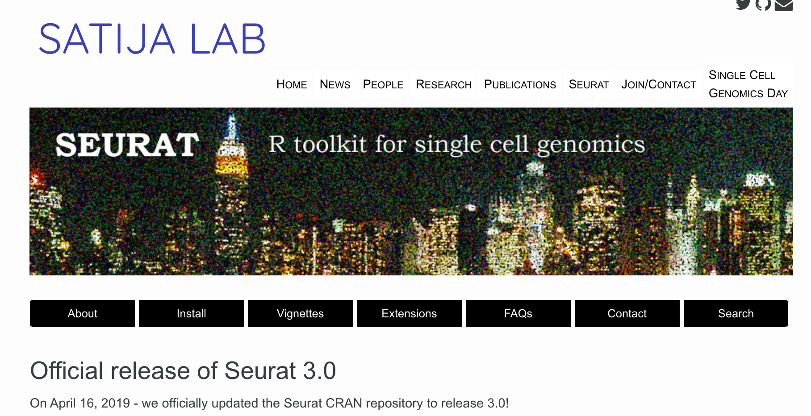
Seurat v 3
Available tools how to implement them
Single Cell User’s Group
12/18/19
https://satijalab.org/seurat/
Presenters:
Jamie Diemer (NHGRI)
Mike Kelly (NCI)
Stefan Cordes (NHLBI)

Slide 2
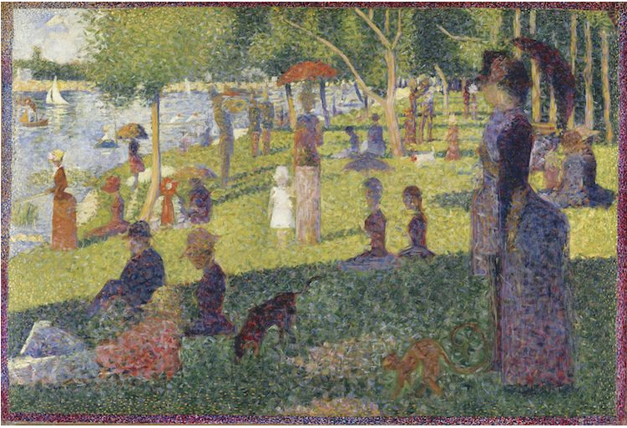
Seurat v 3
Available tools how to implement them
Single Cell User’s Group
12/18/19
https://satijalab.org/seurat/
“A Sunday Afternoon on the Island of La Grande Jatte” Georges Seurat, 1884
“A tale of two mice” Jamie Diemer, 2019

Slide 3
Outline for today’s presentation
Brief intro to the R Studio workspace and Seurat package
Gross anatomy of a Seurat object
Demo dataset
Datasets:
PBMC 3’-end expression with cell surface proteins (10X v3.1)
PBMC 5’-end expression with cell surface proteins (10X v3.1)
ATAC-seq data from PBMC
Reference Data
hPBMNC SMART-seq2
3 reference data sets of 3’-end expression (10X v2)
Normalization
Integration
Label Transfer

Slide 4
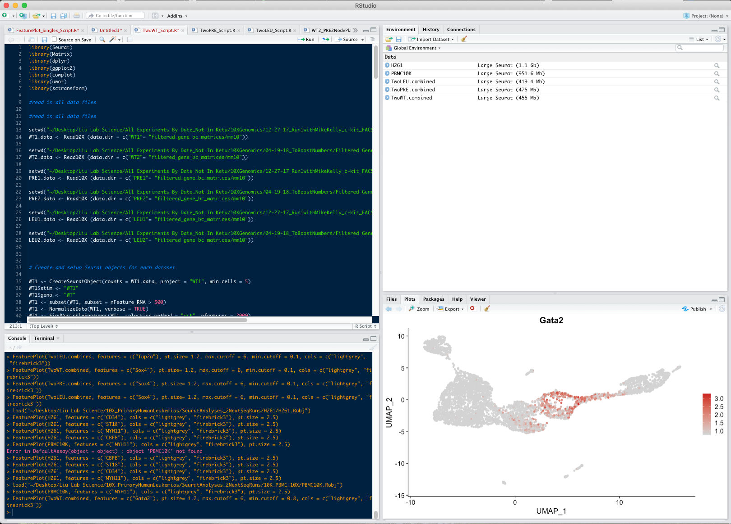
Example R Studio window for an analysis in Seurat
4 working areas of an R studio window

Slide 5
Example R Studio window for an analysis in Seurat
Console
script
(saved)
Actively running
script (not saved)

Slide 6
Example R Studio window for an analysis in Seurat
Environment
Open files (e.g. Seurat objects)
script
(saved)

Slide 7
Example R Studio window for an analysis in Seurat
Plots, Packages, and HELP

Slide 8
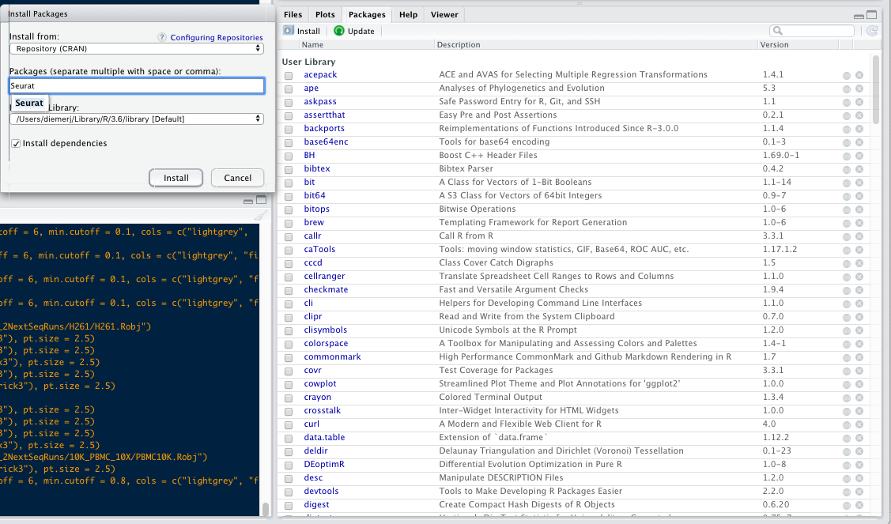
Example R Studio window for an analysis in Seurat

Slide 10
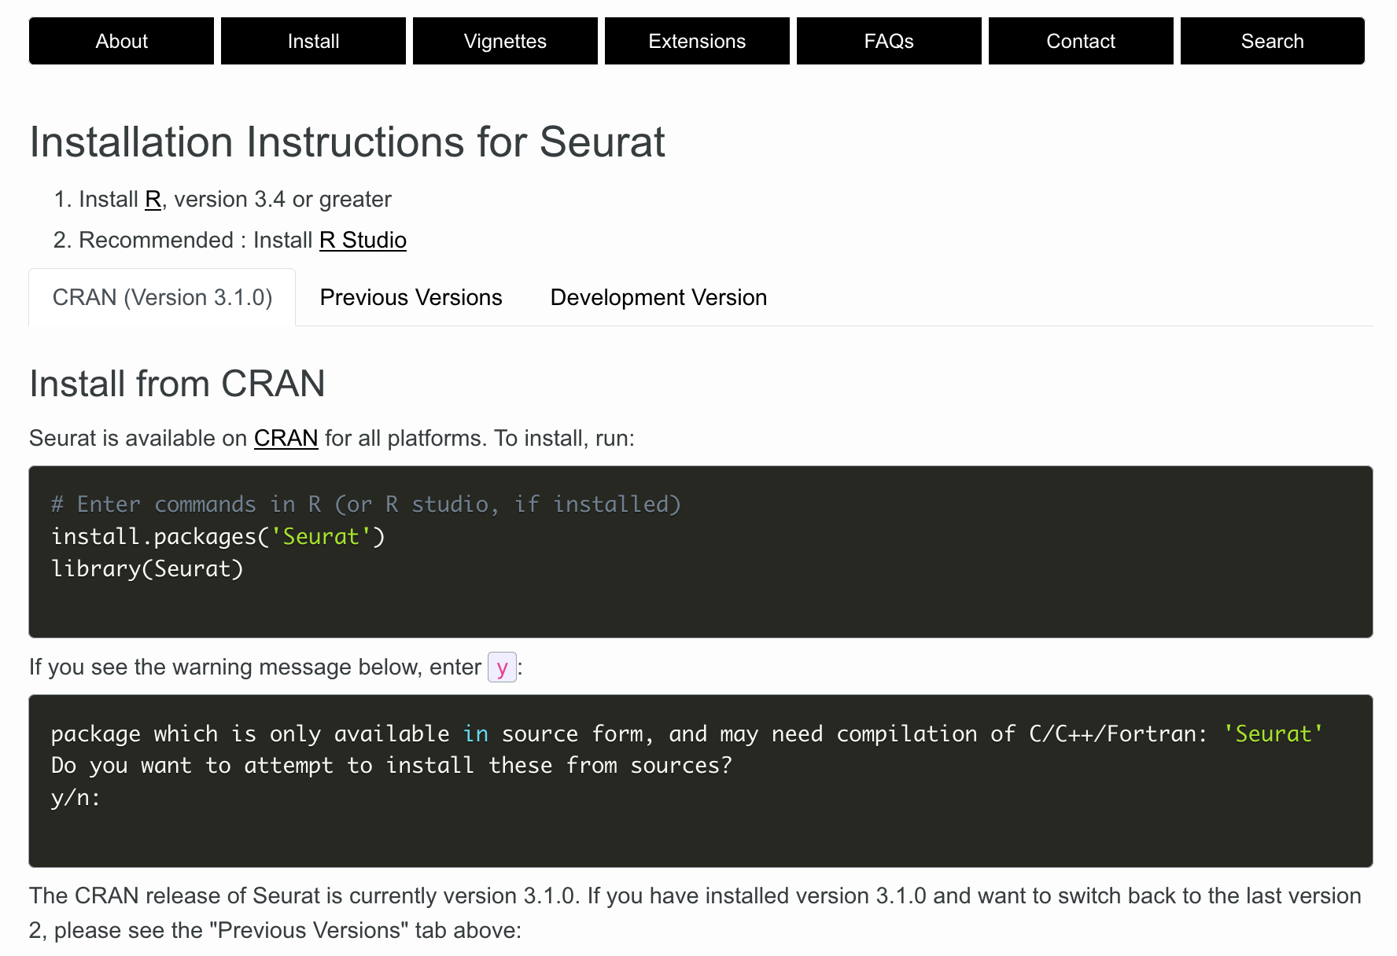

Slide 11
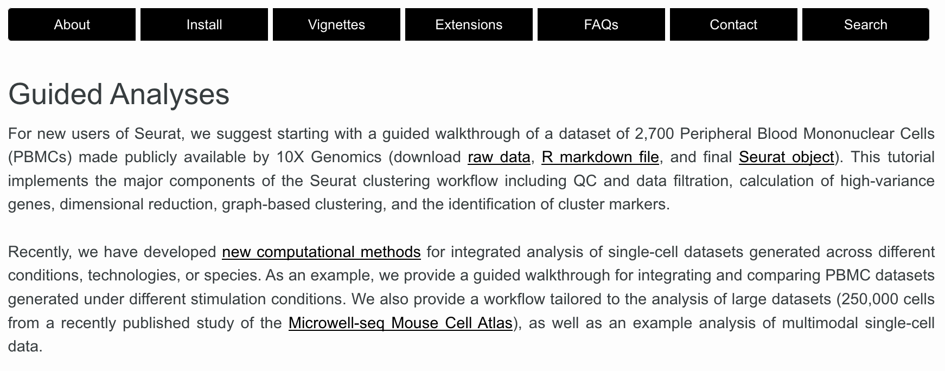
Provided vignettes (with access to practice datasets) are a great learning tool

Slide 12
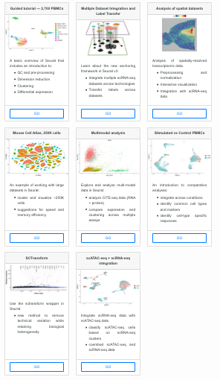
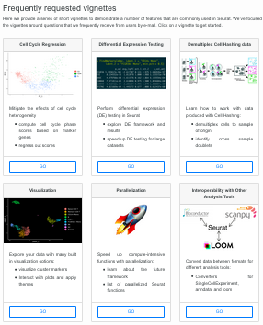
Numerous vignettes available

Slide 13
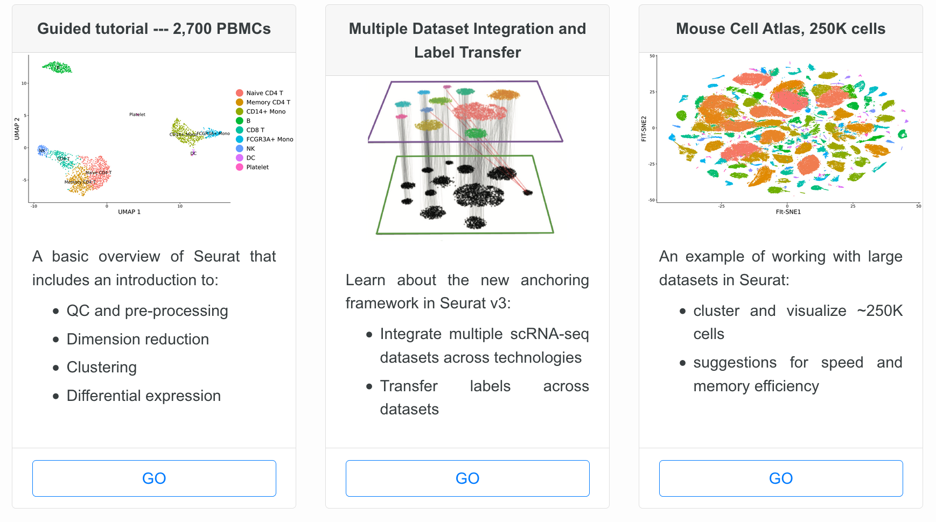
Numerous vignettes available

Slide 14
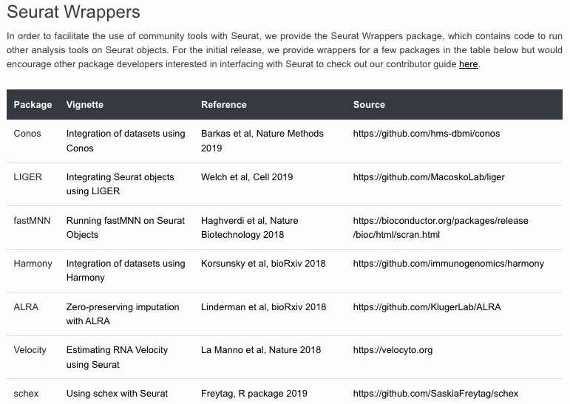

Slide 15
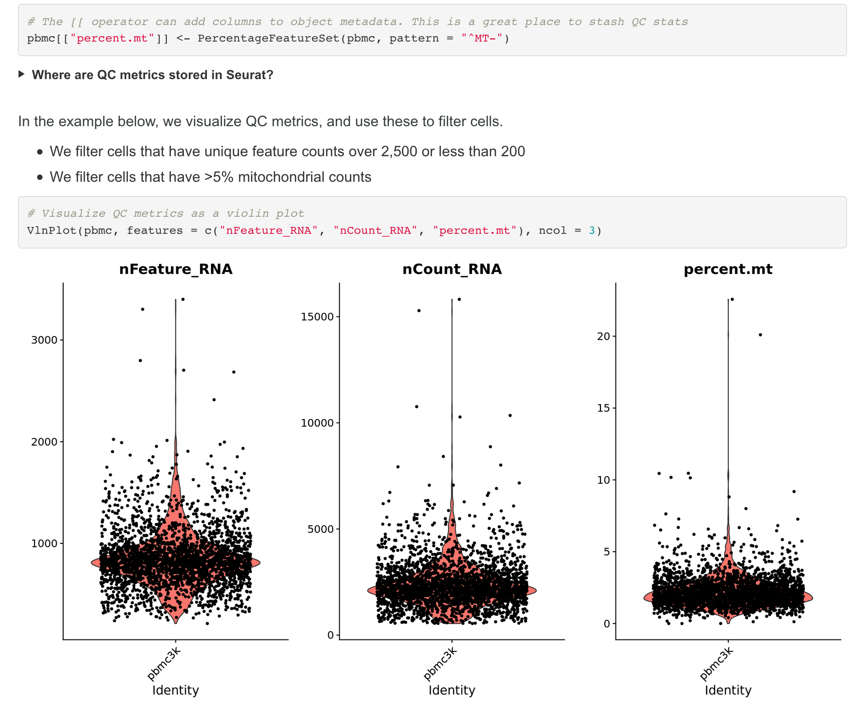
Vignettes give you an explanation of what each step is doing

Slide 16
Tutorial and vignettes are great, but an understanding of the operational commands is crucial
R.object<- RunUMAP(R.object, reduction = "pca", dims = 1:20)
Seemingly simple command…

Slide 17
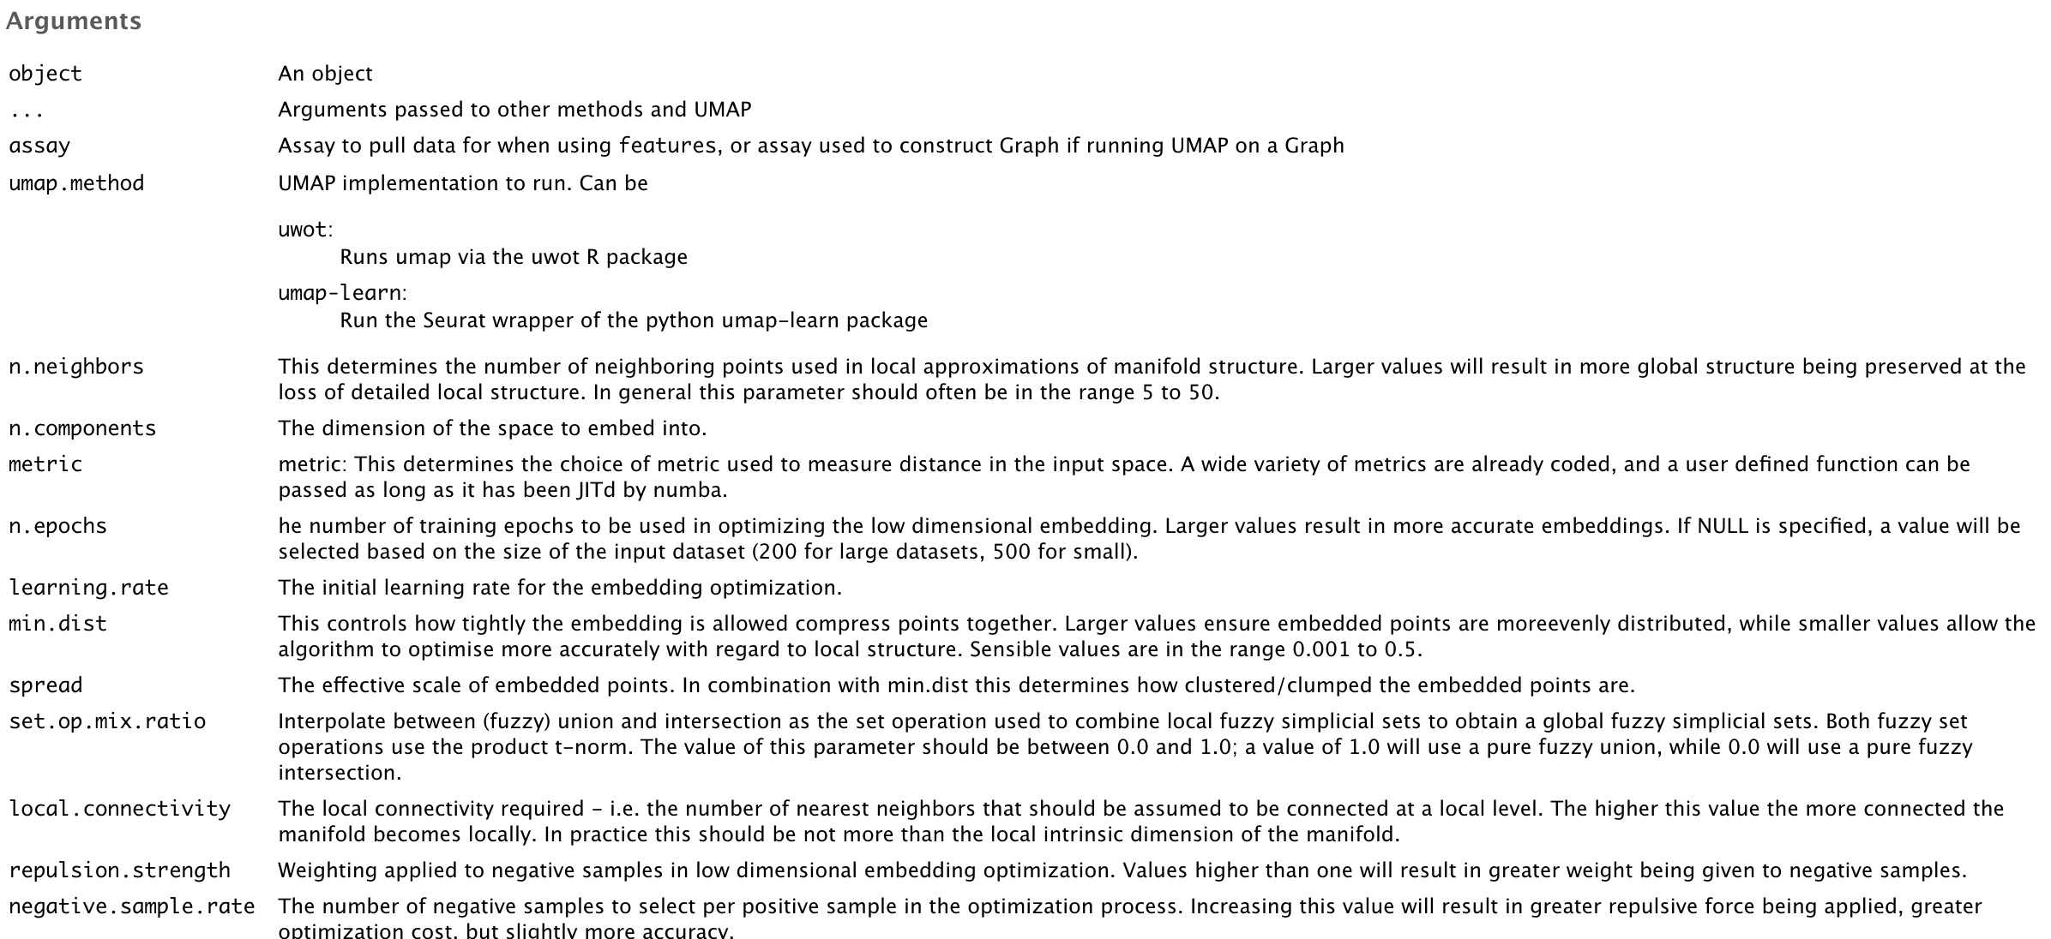
Tutorial and vignettes are great, but an understanding of the operational commands is crucial
R.object<- RunUMAP(R.object, reduction = "pca", dims = 1:20)

Slide 18
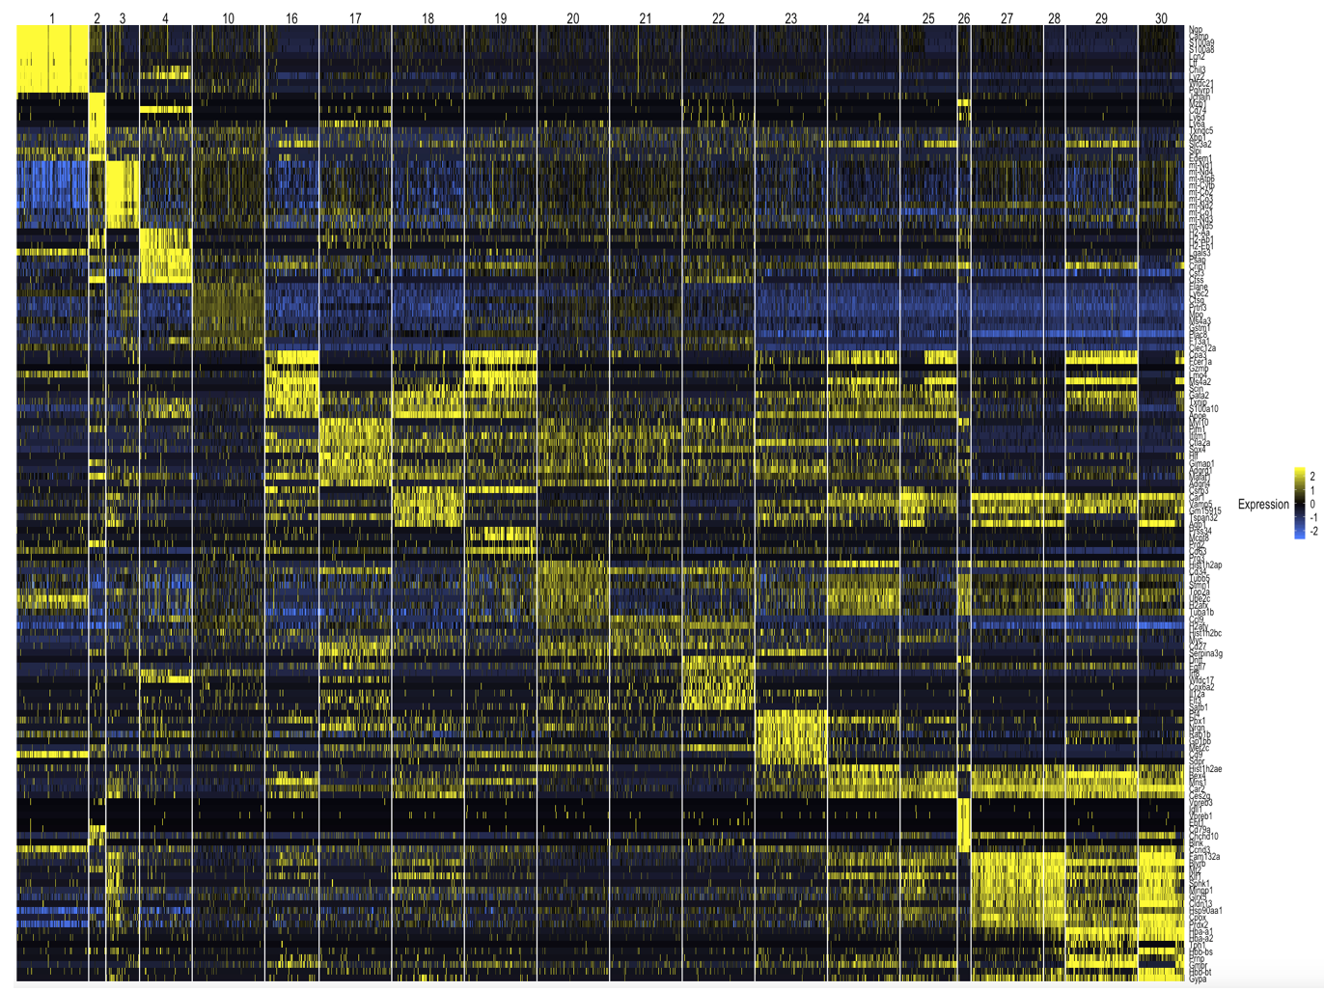
DoHeatmap (object = SubsetData(object = YourObject, max.cells.per.ident = 200), genes.use = features.plot, slim.col.label = TRUE, group.label.rot = F, col.mid = "grey0", col.high = "yellow", col.low = "royalblue1", group.spacing = 0.10, group.label.loc = "top")

Slide 19
Tutorial and vignettes are great, but an understanding of the operational commands is crucial
R.object<- RunUMAP(R.object, reduction = "pca", dims = 1:20)
Seemingly simple command…
The “help” function in R Studio has nice pages for each argument in a script
Best practices: learn which arguments to manipulate (# of PCs, resolution, scaling data, etc etc) and analyze your data several ways

Slide 20
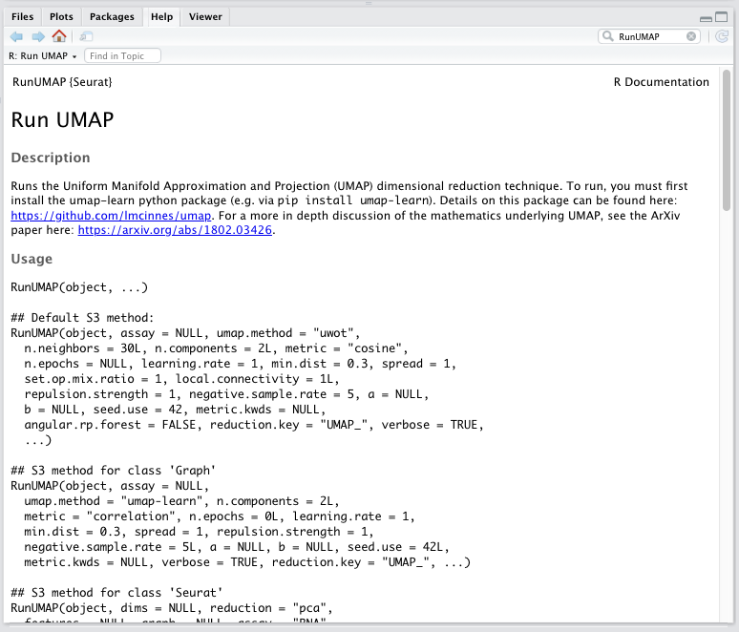
HELP

Slide 21
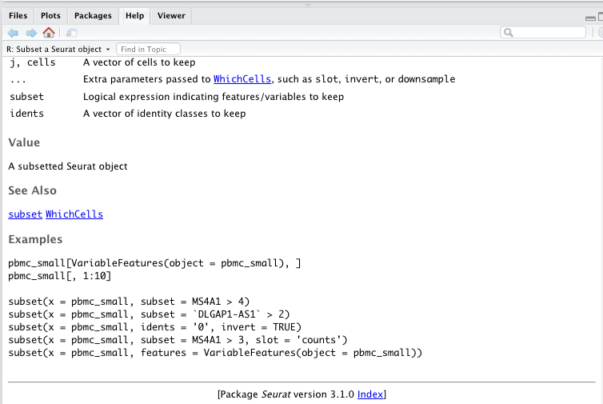
Scroll to the bottom of the Help page to find “Index”

Slide 22
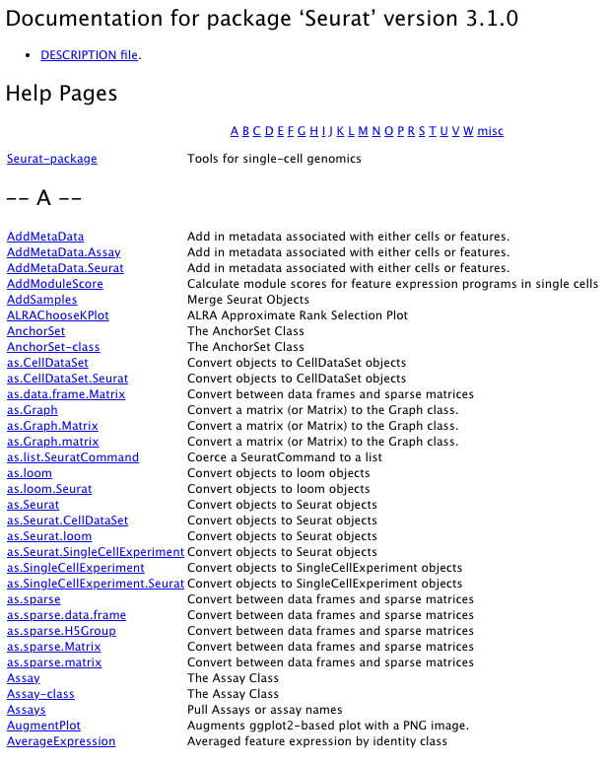
Scroll to the bottom of the Help page to find “Index”

Slide 23
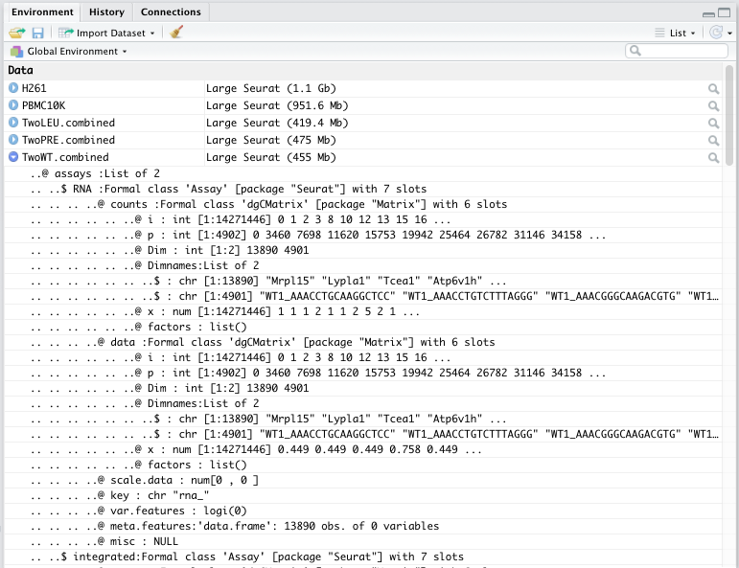
Meta data frame: how to view and understand what’s in your R object

Slide 24
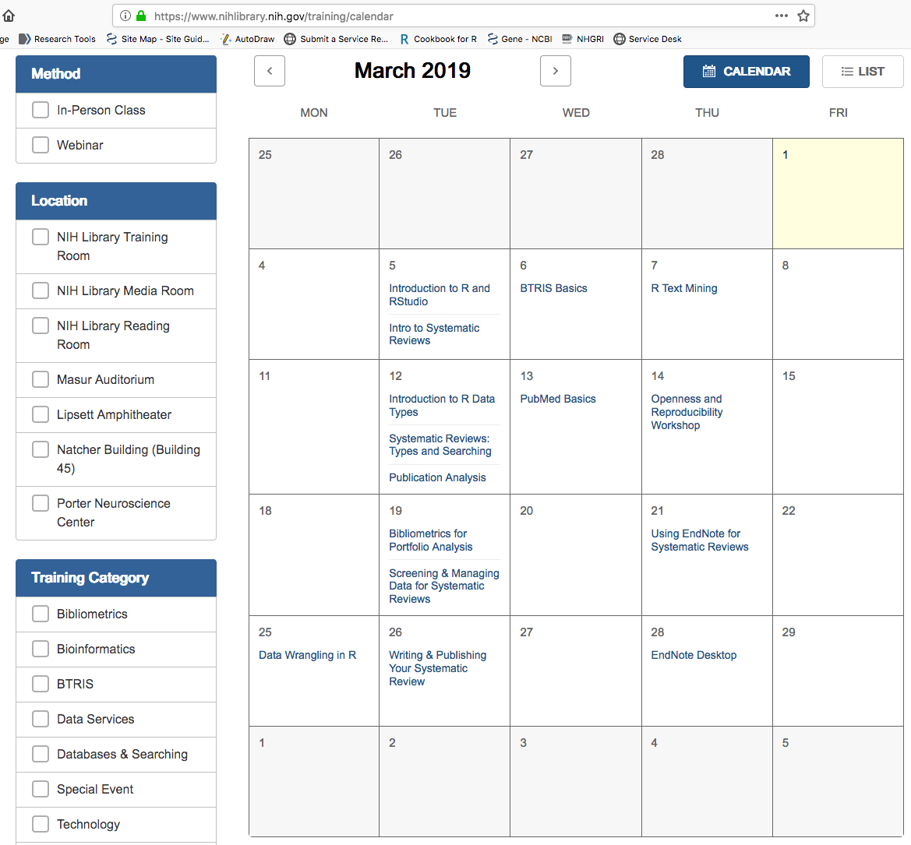
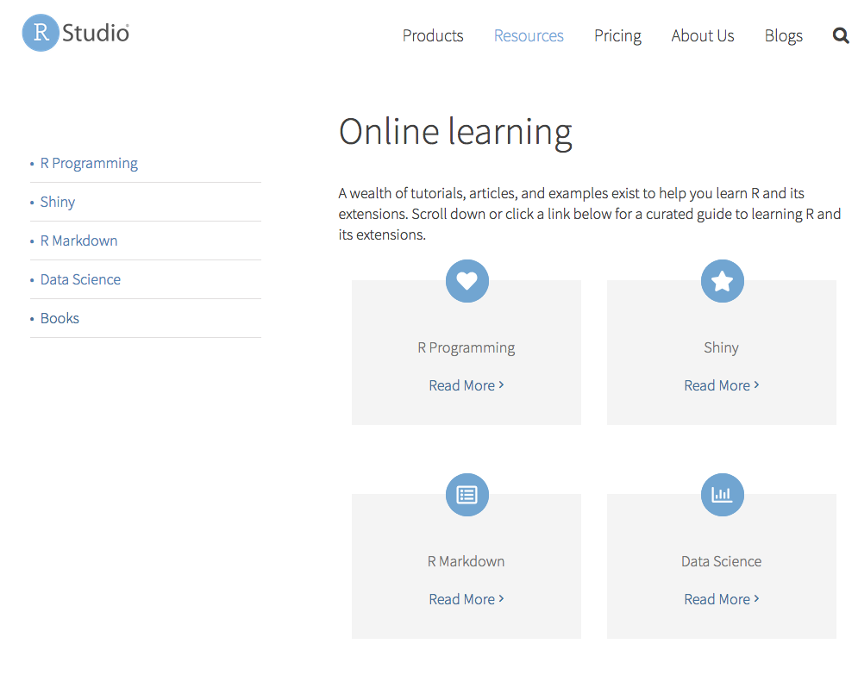
Many resources for R Studio training
NIH Library
https://support.rstudio.com/hc/en-us/articles/201141096-Getting-Started-with-R

Slide 25
Part 2: Gross Anatomy of a Seurat object

Slide 26
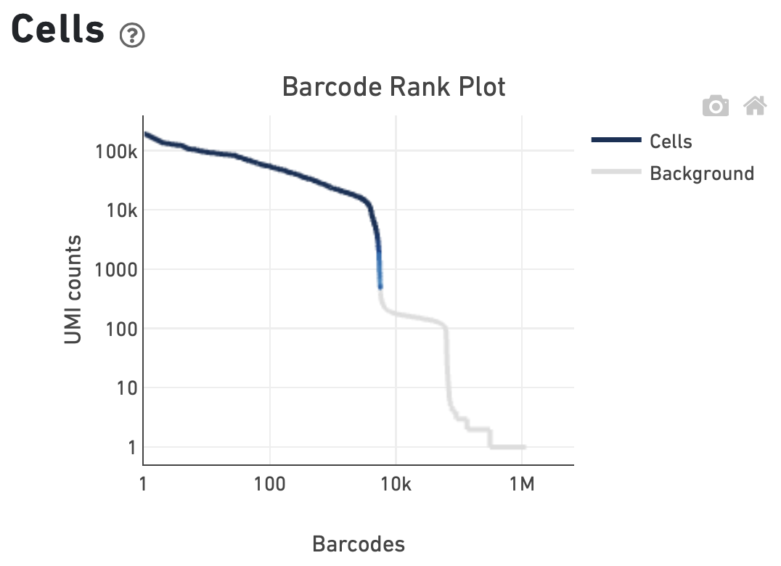
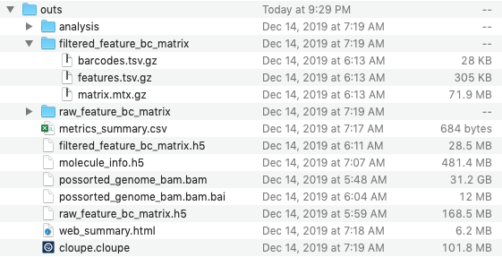
Output of 10x Genomics cellranger pipeline
Cell barcodes in represented by blue line are in ‘filtered_feature_bc_matrix’, all cell barcodes that include those in grey are in ‘raw_feature_bc_matrix’
Feature barcode matrices are provided in two formats (3-file sparse matrix sets) & h5 format. They are roughly equivalent, but h5 is more efficient to use.

Slide 27
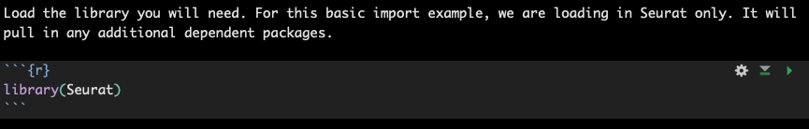
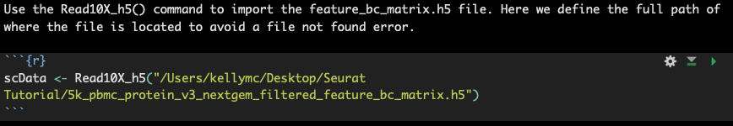
Importing 10x dataset into Seurat (shown in Rstudio)

Slide 28
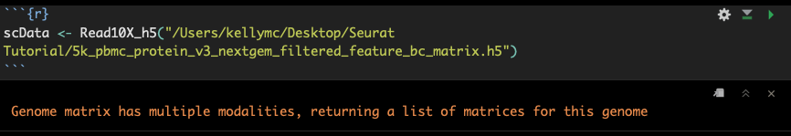
Does your dataset have multiple modalities?
Did your experiment have just gene expression data, or did it also have CITE-Seq / Antibody Feature Barcoding (or similar) add-on’s? Depending on your answer, the imported data may differ
Gene Expression Only:
1 sparse matrix (dgCMatrix)
Gene Expression & Antibody Capture:
List of 2 sparse matrices (dgCMatrix)
scData
scData$’Gene Expression’
scData$’Antibody Capture’

Slide 29
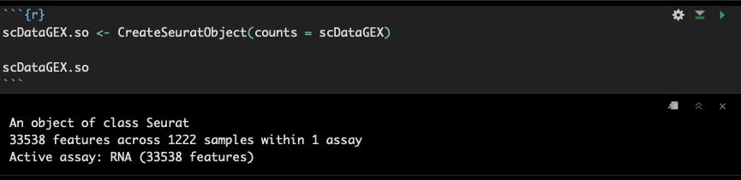
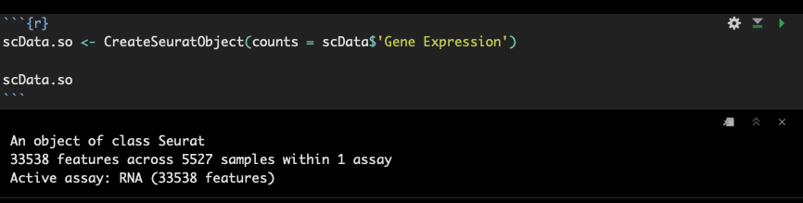
Seurat object is created from the imported counts matrix
If you only have gene expression
Or, If you have gene expression and feature barcode

Slide 30
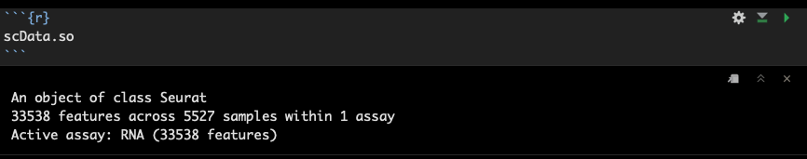
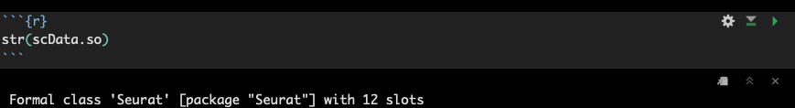
Now you have a Seurat ‘object’ – what is it?
When you just type the object name, you get a very brief, simply formatted summary
There’s a lot more detail underneath that is worth knowing the basic anatomy of….
str() allows the display of the internal structure of an object and shows there are 12 ‘slots’ in a Seurat v3 object

Slide 31
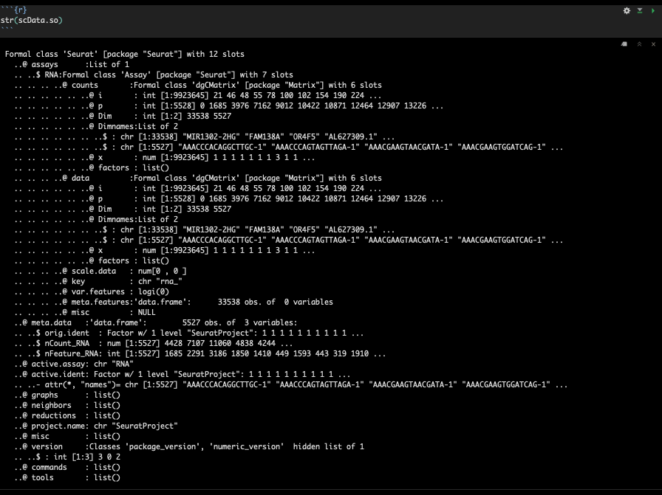
@assay slot: The heart of the object – where the expression matrices are stored. Currently just the (1) gene expression assay ($RNA) that is in the raw counts format
@meta.data slot: the place where metrics and details of each sample are stored. Populated with basic metrics with object creation, added to during processing, and you can add custom fields
@reductions slot: location where pca, umap, tsne and other dimensionality reduction info store

Slide 32
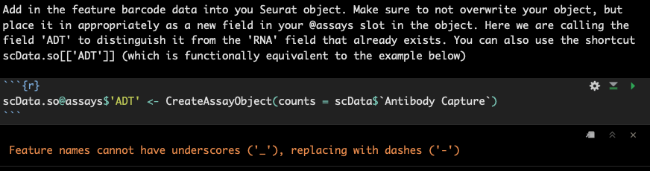
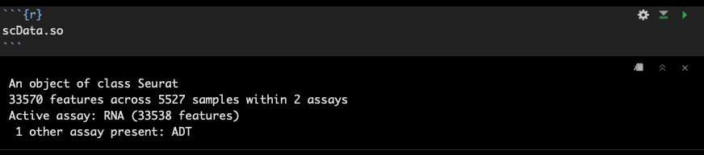
The Seurat object updates as you add to or process your dataset
And now we have (2) assays in the Seurat object

Slide 33
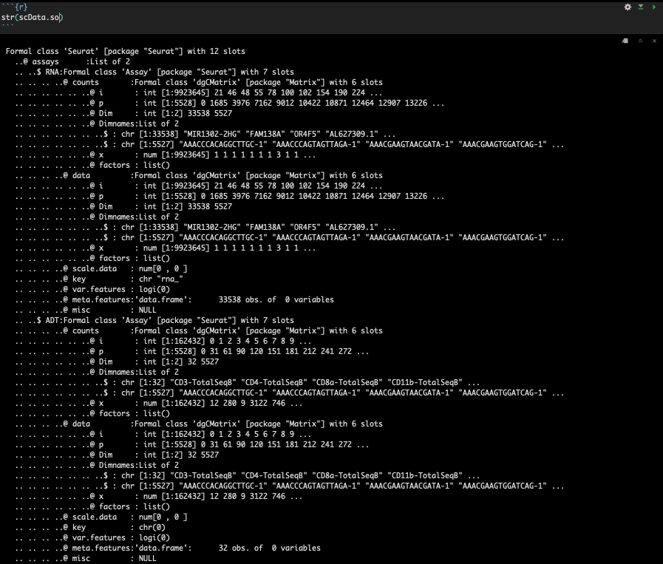
Notice we now have two fields in the @assays slot
The matrices still only just have the raw data in them. The data and scale.data matrices will get updated as you process (Stefan will show this)
The @active.assay slot (not shown here) also become relevant since it shows which matrix you are working on for any processing --- also helpful to pay attention to active assay before and after running SCTransform (active assay becomes ‘SCT’)
str(scData.so) output continues below

Slide 34
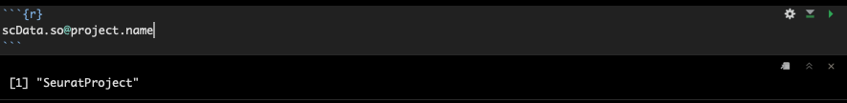
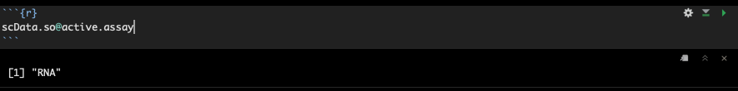
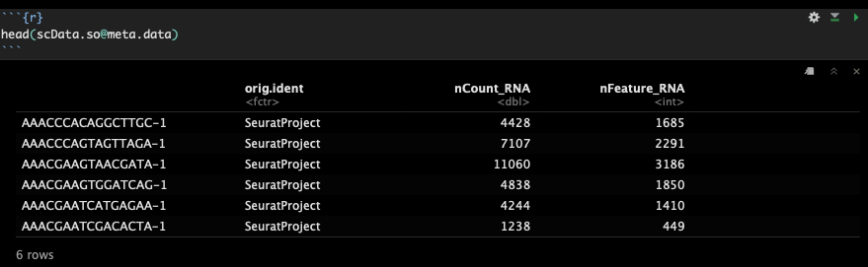
You can get a ‘status check’ of your Seurat object by calling info from these slots
And arguably one of the most helpful / important – the @meta.data slot
(just remember it has as many rows as your dataset has cell barcodes) – using head() to display only the first 6 rows)

Slide 35
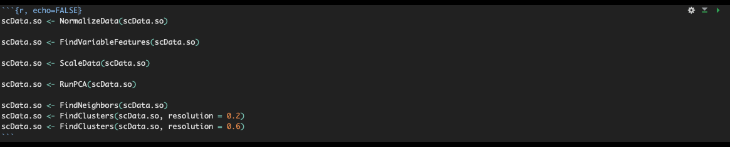
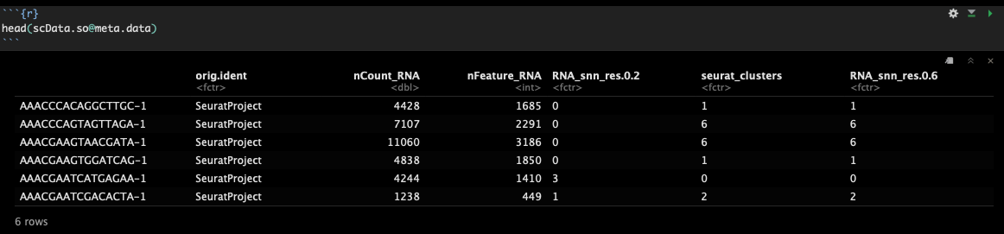
Important info is stored in the Seurat meta.data slot
Some quick default processing just as an example…
Results in automatic updates to the @meta.data table
(note: ‘seurat_clusters’ is the currently-active cluster designations that show up when you plot your data)

Slide 36
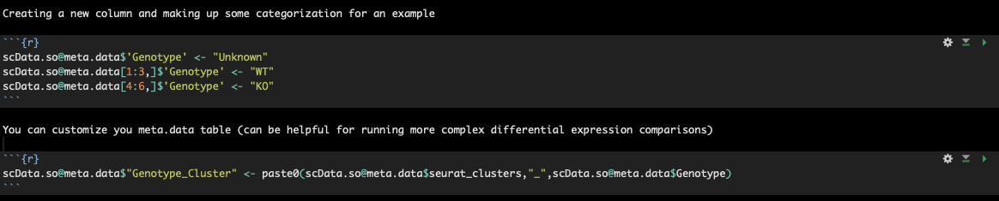
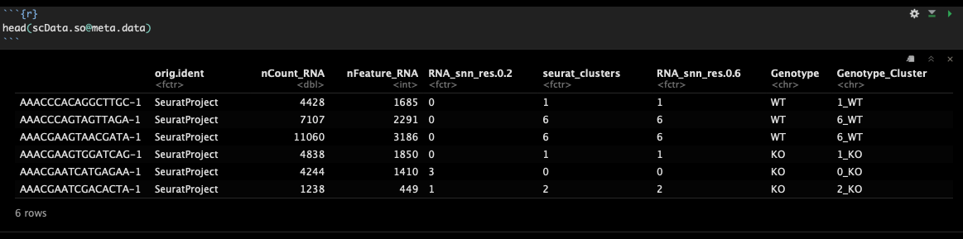
Once you know how to navigate the Seurat object and meta.data slot, you can customize and leverage it for analysis
You can see these new columns in the @meta.data slot

Slide 37
Part 3: Demo dataset
Let’s play

Slide 38
Seurat, V3 FlyOver
Single Cell Users Group
December 18, 2019

Slide 39
Outline
Datasets:
PBMC 3’-end expression with cell surface proteins (10X v3.1)
PBMC 5’-end expression with cell surface proteins (10X v3.1)
ATAC-seq data from PBMC
Reference Data
hPBMNC SMART-seq2
3 reference data sets of 3’-end expression (10X v2)
Normalization
Integration
Label Transfer

Slide 40
Data
Freely available from 10X genomics:
https://www.10xgenomics.com/resources/datasets/
We’ll work with PBMNCs from a healthy donor
3’ Gene Expression + cell surface proteins (v3)
5’ Gene Expression + cell surface proteins (v3)
ATAC-seq
Annotated Reference Datasets are freely available from Satija Lab via the SeuratData package

Slide 41
Data
The data we are using from 10X is in hierarchical data format (HDF)
Useful for storing/organizing large amounts of data
Self-describing: the data and metadata are in the same file
Cross platform
May be viewed in HDFView
The data contains gene expression levels alongside the abundance of cell surface proteins (CITE-seq)
My naming convention:
_data: raw count matrix
_so: a Seurat Object
_sol: a list of Seurat Objects

Slide 42
Normalization
Observed sequencing depth (number of genes or molecules detected per cell) can vary significantly between cells
These effects are due to differences in …
Numbers of PCR copies – mitigated by use of UMIs
Cell lysis
Reverse transcription efficiency
Stochastic molecular sampling during sequencing
The objective in normalization is to remove technical effects, while preserving biological variation
Notes:
Even within the same cell type, sequencing depth can vary by as much as an order of magnitude.

Slide 43
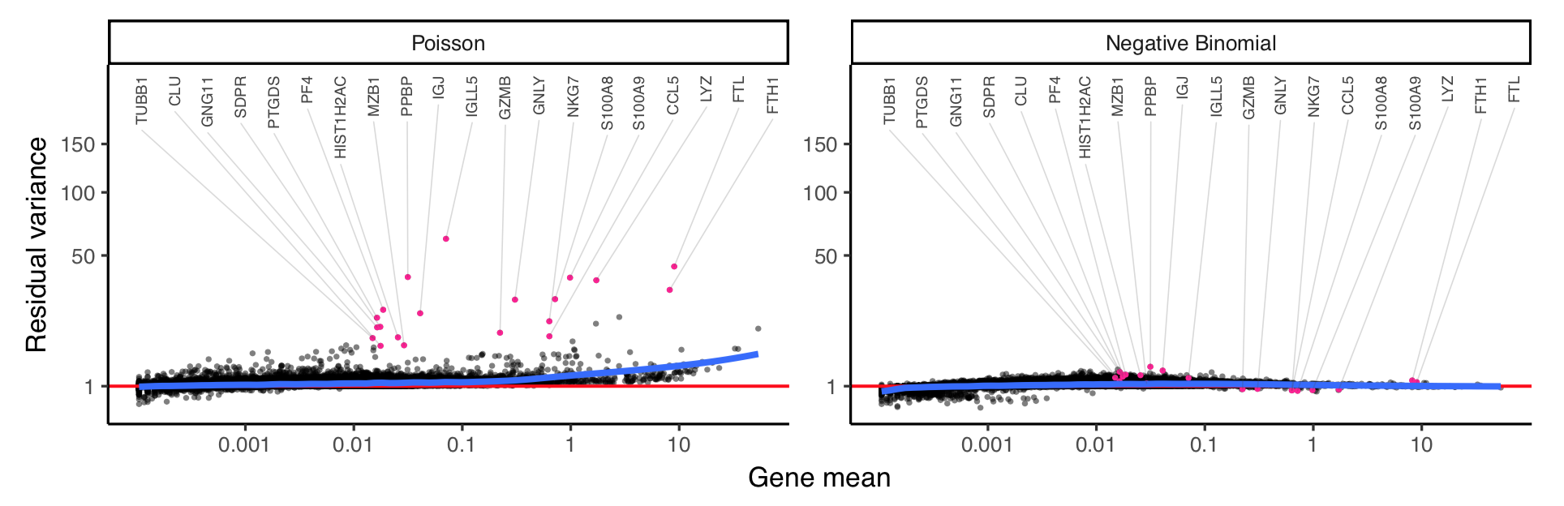
(Previous) Normalization Methods
Poisson model does not fully capture the variance in highly expressed genes
Unconstrained Negative Binomial (NB) or Zero Inflation Negative Binomial models overfits scRNA-seq data and results in significant damping of variance

Slide 44
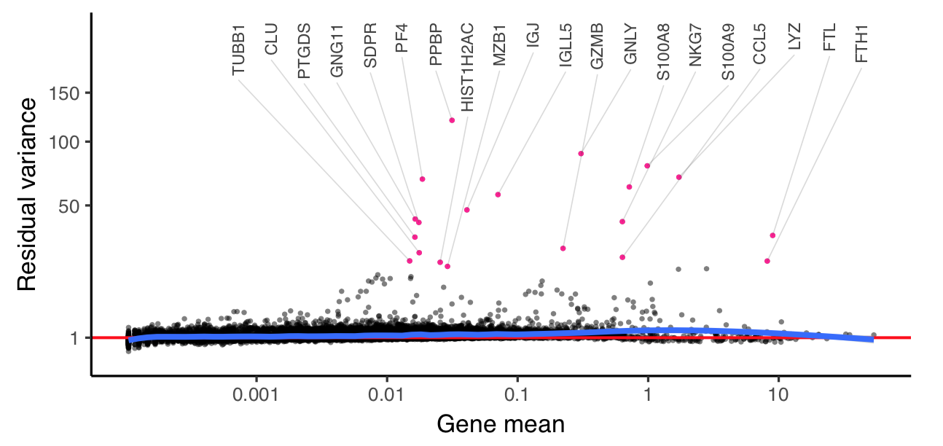
SCTransform
Hafemeister et al propose a regularized negative binomial model
Parameters are computed across pools of genes with similar mean abundance

Slide 45
Data Alignment and Integration
Computational strategy for integrated analysis of scRNA-seq data sets
Motivated by problems in speech recognition and machine vision, where the problem is to synthesize images of an object from different perspectives (front/back, up/down, etc) and different imaging modalities (ultrasound, lidar, etc.)
Novelty in latest version of Seurat is that they identify correspondences between pairs of data set (‘anchors’)

Slide 46
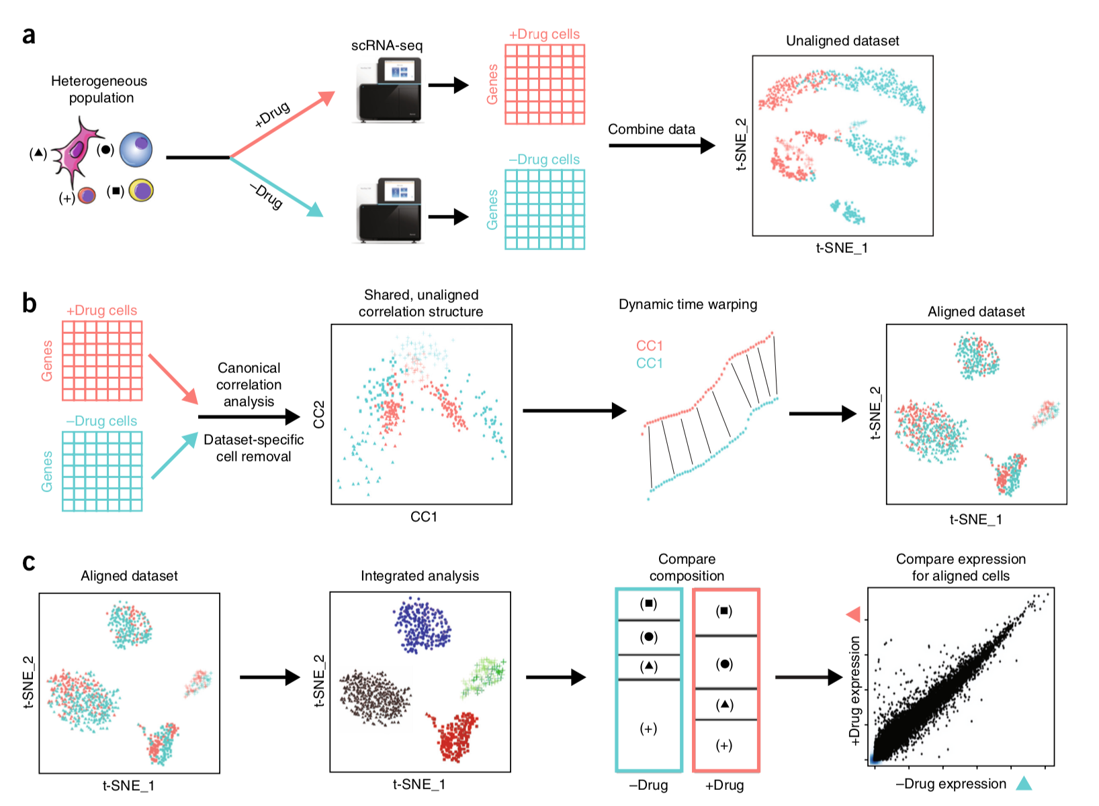
Data Alignment – Seurat v2

Slide 47
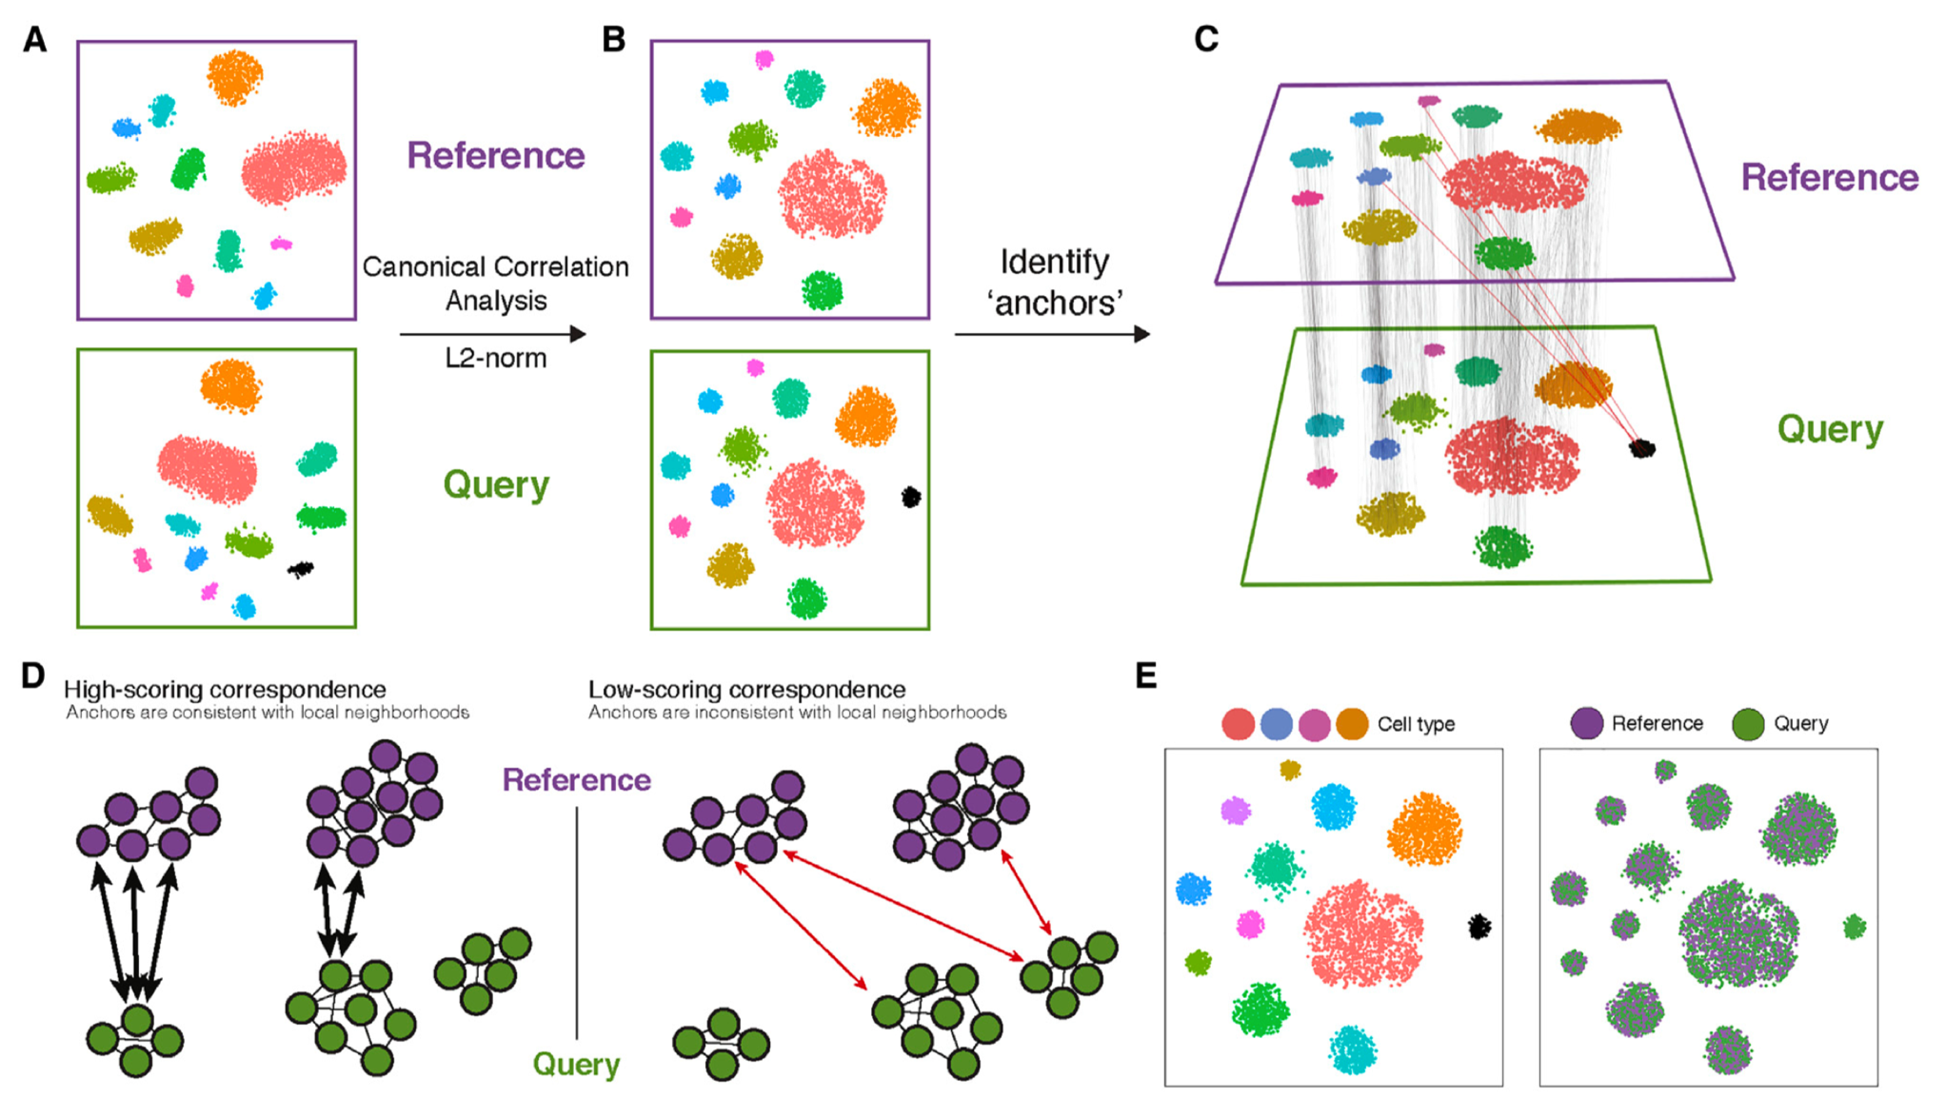
Data Alignment and Integration– Seurat v3

Slide 48
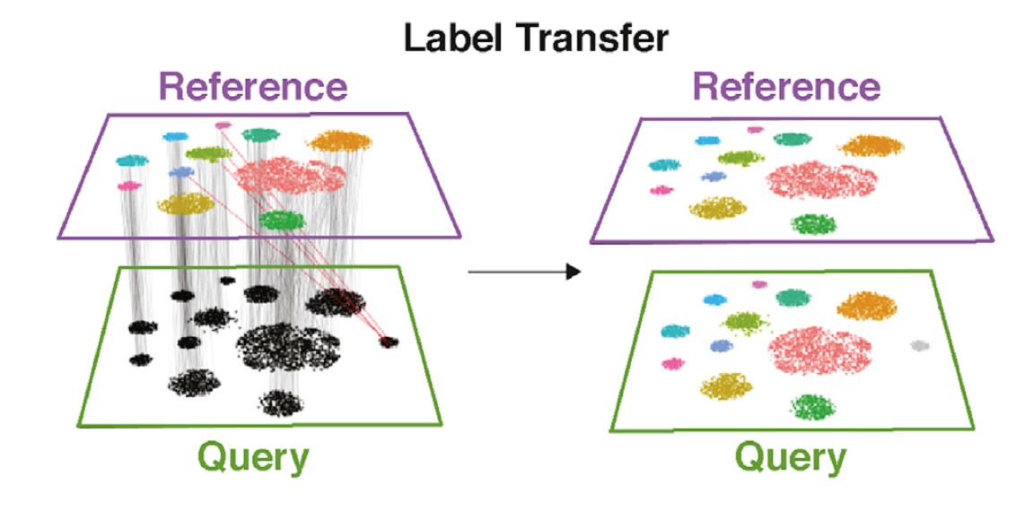
Label Transfer – Seurat v3

Slide 49
Transferring Labels Across Modalities
scATAC-seq characterizes chromatin accessibility on the single cell level
Using the number of observed reads at gene promoters and enhancers, ATAC-seq data is converted to a “gene activity matrix”
Seurat v3 uses the “gene activity matrix” as a synthetic scRNA-seq data set that can be integrated with reference data to transfer labels such as cell type
Not only can discrete labels be transferred from reference to query datasets, but continuous/multimodal quantities (such as protein expression) may also be transferred

Slide 50
Words of Warning
We hope that this R markdown will be useful to you in initial explorations of your data, but …
Ideas presented here are deeper than they appear
Exercise care in pre-processing of your count matrices
Be mindful of whether the datasets you are trying to integrate or the reference dataset you are trying to query are indeed compatible.

Slide 51
Thank You
All the members of my community from whom I have learned most of this

